Slide 1
Creative Thinking and Innovation Automated Bin Messenger
By
E KEVIN FRASER (2019102064)
K LOGESH (2019102066)
D MOHITH (2019102087)
SS KRISHNAKUMAR(2019102065)

Slide 2
Idea Overview
With increase in population, the scenario of cleanliness with respect to garbage management is degrading tremendously. The overflow of garbage in public areas creates the unhygienic conditions in the nearby surrounding. In our city we see the garbage bins or dustbins placed at places overflowing. It creates unhygienic conditions and may provoke several diseases to the surrounding people. Generally, we see that they have a regular schedule of picking up these garbage bins or dustbins. This schedule varies as per the population of that place. It can be once in a day or twice in a day or in some cases once in two days. However we see that in case there is some festival or some function, lots of garbage material is generated by people in a particular area. To avoid all such situations, we are going to implement this project.

Slide 3
PROBLEM STATEMENT
A large number of dust bins are required for an office for waste management.
These bins are replaced by a single automated bin installed in each floor of an office.
Automated Bin Messenger monitors the garbage level all the time and gives information. If the threshold level is reached,
A warning message is sent to the concerned authority via SMS.
Smart bins are used only to monitor the trash level in the bin and send an SMS to authority.

Slide 4
EXISTING SOLUTION
There needs to be a system that gives prior information of the filling of the bin that alerts the municipality
So that they can clean the bin on time and safeguard the environment.
To avoid all such situations we intend to propose a solution for this problem "Smart Bin",
Which will alarm and inform the authorized person when the bin is about to be filled.
Then a message will be sent to the authorized person to collect the garbage from the particular area.

Slide 5
Proposed solution
In this work, we present an automated bin messenger alerts the concerned authority via the GSM. "Smart Bin", which will alarm and inform the authorized person when the bin is about to be filled. Then a message will be sent to the authorized person to collect the garbage from the particular area.
A project has been developed to control the overfilling of the dustbin by making the dustbin smart enough to notify itself for its cleaning.
In this project the smart dustbin management system is built on the microcontroller based system having ultrasonic sensors on each of the four dustbins that will show the current status of garbage on the LCD screen as well as on the mobile.

Slide 6
Need for the product
ARDUINO BOARD
GSM BOARD
ULTRA SONIC SENSOR
JUMPER CABLE
SIM
IR SENSOR

Slide 7
Market Analysis
The global waste management market size was valued at $1,612.0 billion in 2020, and is expected to reach $2,483.0 billion by 2030, registering a CAGR of 3.4% from 2021 to 2030. Waste management is the collection, transportation and disposable of garbage, sewage, and other waste products.
It involves treating solid waste and disposing unwanted products and substances in a safe and efficient manner. Waste management includes all types of waste including solid, liquid, or gas. Waste management deals with municipal, industrial, and hazardous waste.
Municipal waste generally refers to residential waste and non-hazardous waste generated in towns and cities. Industrial waste refers to waste generated in industries while production and manufacturing processes.
Hazardous waste refers to waste generated in pharmaceuticals, medicals, chemicals, and paint manufacturing industries.

Slide 8
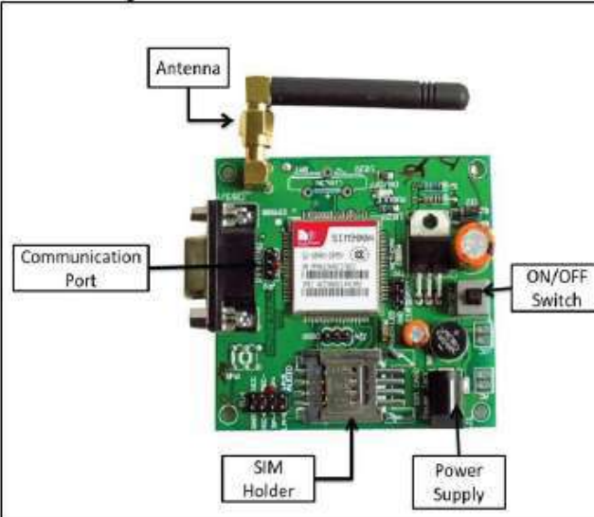
Financial Estimation
ARDUINO BOARD -RS.3200
GSM BOARD-RS.1500
ULTRA SONIC SENSOR- RS.100
JUMPER CABLE-RS.200
SIM-RS.100
IR SENSOR-RS.100

Slide 9
REFERENCES
[1] Narayan Sharma, NirmanSingha, Tanmoy Dutta (2015)“Smart Bin Implementation for Smart Cities”
International Journal of Scientific & Engineering Research, vol 6, Issue 9, pp-787-789.
[2] K. Vidyasagar, M. Sumalatha, K. Swathi and M. Rambabu (2015)
“Eco-friendly Environment with RFID Communication Imparted Waste Collecting Robot”,
Journal of Academia and Industrial Research (JAIR)Volume4,Issue2,pp.43-47.0

Slide 10
Conclusion
In this work, we present an automated bin messenger alerts the concerned authority via the GSM.
Where it provides the values which determine the amount of trash filled.
This information is communicated to the caretakers using GSM technology
With the advent of technologies, all the things around us are getting smarter. The above-depicted model of smart trash is cost effective and can be implemented in malls, airports, hospitals, schools, and colleges. which reduces the burden of people

Slide 11

THANK YOU

